Slide 1
Announcement & Reminder (Sep 18)
Hw #1: due: Friday Oct 6 11:59pm
submission online using the class Moodle site
Please start working on them!
Next week: Programming Project # 1 will be handed out!
Due Monday Oct 15 11:59pm

Slide 2
We Have Learned Last Time
Weekly Summary

Slide 3
What We Learned Last Time (Sep 11)
What is a network? What is a computer/data network? Compare w/ diff. networks (telephone, postal office, transportation networks, …)
“bolts-&-nuts” view vs. service perspective
Network is a shared resource!
ways to share (“multiplex”) resources? TDMA, FDMA, CDMA, …
Packet switching vs. circuit switching:
packets, packet switching and statistical multiplexing
For “bursty” data applications
store-&-forward
delay, losses and congestion vs. call blocking
New: four types of delays
propagation, transmission, processing & queueing delays
New: Architecture: layering & hourglass
different technologies, “boxes” (routers, switches), & apps
Protocols and Interfaces (API)

Slide 4
Switching & Multiplexing
Network is a shared resource
Provide services for many people at same time
Carry bits/information for many people at same time
How do we do it?
Switching: how to deliver information from point A to point B?
Multiplexing: how to share resources among many users
Think about postal service and telephone system!
Switching and multiplexing are closely related!

Slide 5
Switching/Multiplexing Strategies
Circuit switching
set up a dedicated route (“circuit”) first
carry all bits of a “conversation” on one circuit
original telephone network
Analogy: railroads and trains/subways
Packet switching
divide information into small chunks (“packets”)
each packet delivered independently
“store-and-forward” packets
Internet
(also Postal Service, but they don’t tear your mail into pieces first!)
Analogy: highways and cars
Pros and Cons?
- think taking subways vs. driving cars, during off-peak vs. rush hours!

Slide 6
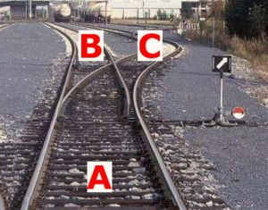
Analogy: railroad and train
CSci4211: Introduction
6

Slide 7
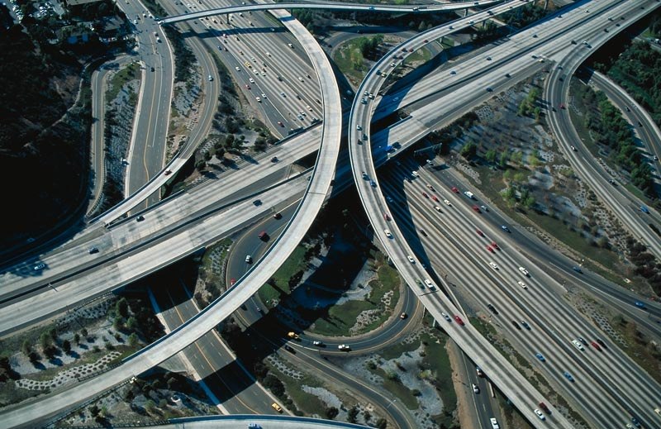
Analogy: Highway and cars
CSci4211: Introduction

Slide 8
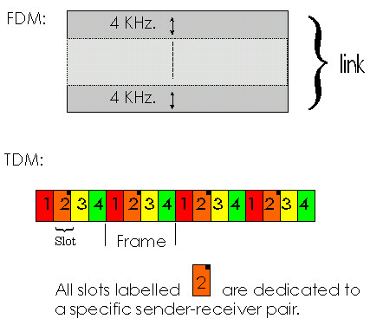
Circuit Switching
network resources (e.g., bandwidth) divided into “pieces”
pieces allocated to calls
resource piece idle if not used by owning call (no sharing)
dividing link bandwidth into “pieces”
frequency division
time division
code division
Trivia Q:
You must have heard of the term “CDMA” (think the company Qualcom, for which it is most associated with), what does “CD” in CDMA stands for?
CSci4211: Introduction

Slide 9
Circuit Switching: FDM and TDM
Example:
FDM
4 users
frequency
time
TDM
frequency
time
CSci4211: Introduction
Notes:
Two simple multiple access control techniques.
Each mobile’s share of the bandwidth is divided into portions for the uplink and the downlink. Also, possibly, out of band signaling.
As we will see, used in AMPS, GSM, IS-54/136

Slide 10
Networks with Circuit Switching e.g., conventional (fixed-line) telephone networks
End-end resources reserved for “call”
link bandwidth, switch capacity
dedicated resources: no sharing
circuit-like (guaranteed) performance
call setup required

Slide 11
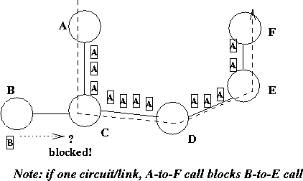
Circuit Switched Networks
All resources (e.g. communication links) needed by a call dedicated to that call for its duration
Example: telephone network
Call blocking when all resources are used
Notes:
Under circuit switching, all the resources needed by a call are dedicated to that call for the duration of the call. This is used in telephone networks. Good thing about it is its guaranteed service. You are assured of the required resources for the entire duration of the call. The bad thing is that resources are not utilized efficiently. There may be silent periods during the talk but the dedicated network resources cannot be used by other calls. Whether you are shouting or silent you consume the same amount of network resources.
What happens when the resource demands exceed the resources available. For example, there is only one circuit/link. Lets say is A is currently occupying the circuits between C-D and D-E. Now suppose B wants to call E. Then B is blocked. Once call is admitted, you are guaranteed to have good quality of service.

Slide 12
Numerical example
How long does it take to send a file of 640,000 bits from host A to host B over a circuit-switched network?
All links are 1.536 Mbps
Each link uses TDM with 24 slots/sec
500 msec to establish end-to-end circuit
Let’s work it out!
10.5 seconds

Slide 13
Packet Switching
Each end-end “data stream” divided into packets
users A, B packets share network resources
each packet uses full link bandwidth
resources used as needed
resource contention:
aggregate resource demand can exceed amount available
congestion: packets queue, wait for link use
store and forward: packets move one hop at a time
Node receives complete packet before forwarding
Packets may suffer delay or losses!
Bandwidth division into “pieces”
Dedicated allocation
Resource reservation

Slide 14
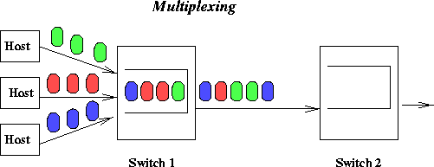
Statistical Multiplexing
Time division, but on demand rather than fixed
Reschedule link on a per-packet basis
Packets from different sources interleaved on the link
Buffer packets that are contending for the link
Buffer buildup is called congestion
This is packet switching, used in computer networks

Slide 15
Packet Switching: Statistical Multiplexing
100 Mb/s
Ethernet
A
C
statistical multiplexing
1.5 Mb/s
B
queue of packets
waiting for output
link
D
E
Sequence of A & B packets does not have fixed pattern, shared on demand ➔ statistical multiplexing.
TDM: each host gets same slot in revolving TDM frame.

Slide 16
Packet-switching: store-and-forward
L
R
R
R
Takes L/R seconds to transmit (push out) packet of L bits on to link or R bps
Entire packet must arrive at router before it can be transmitted on next link: store and forward
delay = 3L/R (assuming zero propagation delay)
Example:
L = 7.5 Mbits
R = 1.5 Mbps
delay = ?
15 sec
more on delay later …
CSci4211: Introduction

Slide 17
Packet switching versus circuit switching
Packet switching allows more users to use network!
1 Mb/s link
each user:
100 kb/s when “active”
active 10% of time
circuit-switching:
10 users
packet switching:
with 35 users, probability > 10 active less than .0004
N users
1 Mbps link
Q: how did we get value 0.0004?
CSci4211: Introduction

Slide 18
Circuit Switching vs Packet Switching
Item | Circuit-switched | Packet-switched
Dedicated “copper” path | Yes | No
Bandwidth available | Fixed | Dynamic
Potentially wasted bandwidth | Yes | No (not really!)
Store-and-forward transmission | No | Yes
Each packet/bit always follows the same route | Yes | Not necessarily
Call setup | Required | Not Needed
When can congestion occur | At setup time | On every packet
Effect of congestion | Call blocking | Queuing delay
Notes:
Is packet switching is always preferable? Ideally we want circuit switching type service with the efficiency of packet switching. Computer networks use packet switching.

Slide 19
Four sources of packet delay
1. nodal processing:
check bit errors
determine output link
2. queueing
time waiting at output link for transmission
depends on congestion level of router
transmission
A
propagation
B
nodal
processing
queueing
CSci4211: Introduction

Slide 20
Delay in packet-switched networks
3. Transmission delay:
R=link bandwidth (bps)
L=packet length (bits)
time to send bits into link = L/R
4. Propagation delay:
d = length of physical link
s = propagation speed in medium (~2x10⁸ m/sec)
propagation delay = d/s
transmission
A
propagation
B
nodal
processing
Note: s and R are very different quantitites!
queueing

Slide 21
Nodal delay
d_{proc} = processing delay
typically a few microsecs or less
d_{queue} = queuing delay
depends on congestion
d_{trans} = transmission delay
= L/R, significant for low-speed links
d_{prop} = propagation delay
a few microsecs to hundreds of msecs
CSci4211: Introduction

Slide 22
Statistical Multiplexing and Queueing
10 Mbs
Ethernet
A
C
statistical multiplexing
1.5 Mbs
B
queue of packets
waiting for output
link
45 Mbs
D
E

Slide 23
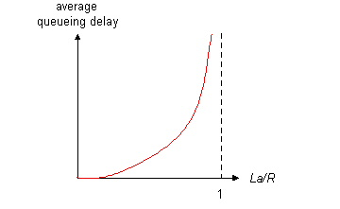
Queueing delay (revisited)
R=link bandwidth (bps)
L=packet length (bits)
a=average packet arrival rate
traffic intensity = La/R
La/R ~ 0: average queueing delay small
La/R -> 1: delays become large
La/R > 1: more “work” arriving than can be serviced, average delay infinite!

Slide 24
Queueing delay and Packet loss
CSci4211: Introduction
Queue (aka buffer) preceding link in buffer has finite capacity
When packet arrives to full queue, packet is dropped (aka lost)
lost packet may be retransmitted by previous node, by source end system, or not retransmitted at all

Slide 25
“Real” Internet delays and routes
What do “real” Internet delay & loss look like?
Traceroute program: provides delay measurement from source to router along end-end Internet path towards destination. For all i:
sends three packets that will reach router i on path towards destination
router i will return packets to sender
sender times interval between transmission and reply.
3 probes
3 probes
3 probes
CSci4211: Introduction

Slide 26
“Real” Internet delays and routes
Let’s Traceroute to www.bbc.com
CSci4211: Introduction

Slide 27
Throughput
throughput: rate (bits/time unit) at which bits transferred between sender/receiver
instantaneous: rate at given point in time
average: rate over longer period of time
link capacity
R_{s} bits/sec
link capacity
R_{c} bits/sec
server, with
file of F bits
to send to client
pipe that can carry
fluid at rate
R_{s} bits/sec)
pipe that can carry
fluid at rate
R_{c} bits/sec)
server sends bits
(fluid) into pipe

Slide 28
Throughput (cont’d)
R_{s} < R_{c} What is average end-end throughput?
R_{s} bits/sec
R_{c} bits/sec
R_{s} > R_{c} What is average end-end throughput?
R_{s} bits/sec
R_{c} bits/sec
bottleneck link
link on end-end path that constrains end-end throughput
CSci4211: Introduction

Slide 29
Throughput: Internet scenario
R_{s}
per-connection end-end throughput: min(R_{c},R_{s},R/10)
in practice: R_{c} or R_{s} is often bottleneck
R_{s}
R_{s}
R
R_{c}
R_{c}
R_{c}
10 connections (fairly) share backbone bottleneck link R bits/sec

Slide 30
Questions?

Slide 31
Introduction (cont’d)
Key network functions:
-- naming, addressing, routing & forwarding
networks are distributed & complex systems!
What’s so special about the Internet?
-- Internet Architecture: layering & hourglass
different technologies, “boxes” (routers, switches), & apps
Protocols and Interfaces (API)
What may go wrong?
bit errors, packet losses,, node failures, software bugs, app crashes. ….. and Attacks !!!
What today’s Internet looks like? economics & policies

Slide 32
What’s so special about the Internet?
Internet is based on the notion of “packet switching”
enables statistical multiplexing
better utilization of network resources for transfer of “bursty” data traffic
Internet’s key organizational/architectural principle: “smart” end systems + “dumb” networks
architecture: functional division & function placement
hourglass Internet architecture: enables diverse applications and accommodates evolving technologies
“dumb” network (core): simple packet-switched, store-forward, connectionless “datagram” service, with core functions: global addressing, routing & forwarding
“smart” end systems/edges: servers, PCs, mobile devices, …; diverse and ever-emerging new applications!

Slide 33
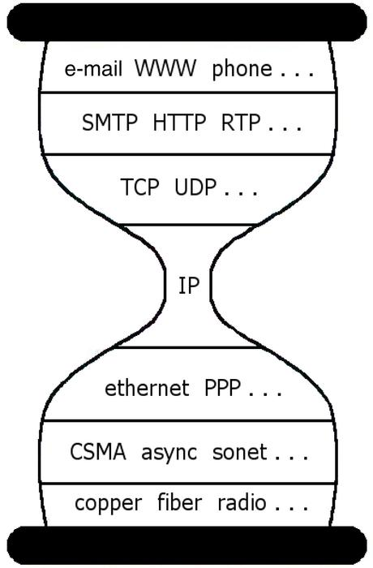
Internet Hourglass Architecture
enabling diverse applications
& new types of end devices
p2p file sharing, skype, YouTube, Netflix, Cloud Computing
bitTorrent, DHT, SIP, DASH, ….
accommodating evolving
& new technologies
network edge/end hosts
network core
WiFi, Bluetooth,
Docsis, gMPLS,
DWDM/fiber, …,
3G/4G cellular,
….

Slide 34
Internet Protocol Stack
application: supporting network applications
FTP, SMTP, HTTP, DASH, …
transport: process-process data transfer
TCP, UDP
network: routing of datagrams from source to destination
IP, routing protocols
link: data transfer between neighboring network elements
PPP, Ethernet
physical: bits “on the wire”
application
transport
network
link
physical
CSci4211: Introduction

Slide 35
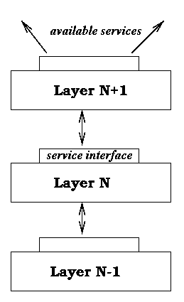
Layered Architecture
Layering simplifies the architecture of complex system
Layer N relies on services from layer N-1 to provide a service to layer N+1
Interfaces define the services offered
Service required from a lower layer is independent of its implementation
Layer N change doesn’t affect other layers
Information/complexity hiding
Similar to object oriented methodology
Notes:
Network software is designed using layered approach to make the complex system manageable. Layer N uses the services provided by the lower layers to offer a service to upper layers. Interfaces define the services offered by a layer.
By keeping the interface same, the implementation of a layer can be changed without affecting the rest of the system. This type of information and complexity hiding is similar to object oriented approach.

Slide 36
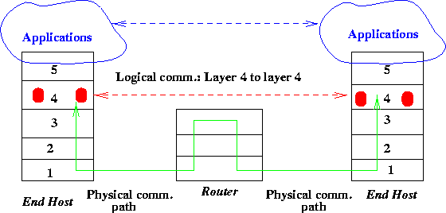
Protocols and Services
Protocols are used to implement services
Peering entities in layer N provide service by communicating with each other using the service provided by layer N-1
Logical vs physical communication
Notes:
Lets look at the relation between services, protocols and interfaces. The interface of a layer defines the service provided by that layer and protocols are used to implement the service according to the interface specification. The protocol is between peer entities and they communicate with each other using the service provided by the lower layer.
Here is an example of communication between peer layers. It is important to understand the difference between logical vs physical communication. For example, layer 4’s communicate with each other using a layer 4 protocol. They exchange messages as if they can talk to each other directly. But in reality, messages go thru the router. Layer 4 uses the services offered by layer 3 to send the message to layer 4 on the other side. The dotted line shows the logical communication path and the solid line, physical communication path. This approach allows design, implementation and testing of a layer software independent of other layers.

Slide 37
What’s a protocol?
human protocols:
“what’s the time?”
“I have a question”
introductions
network protocols:
machines rather than humans
all communication activity in Internet governed by protocols (why this concept is so important!!!)
CSci4211: Introduction

Slide 38
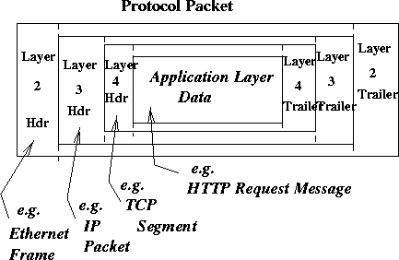
Protocol Packets
Protocol data units (PDUs):
packets exchanged between peer entities
Service data units (SDUs):
packets handed to a layer by an upper layer
Data at one layer is encapsulated in packet at a lower layer
Envelope within envelope: PDU = SDU + (optional) header or trailer
Notes:
Some terminology here. The packets exchanged between peer entities are called PDUs. Packets handed to a layer by an upper layer is called SDU. Data at one layer is encapsulated in a PDU packet at the next layer. This is like putting an envelope within another envelope. A protocol at a layer doesn’t interpret the data handed by the upper layer. For example, application layer data such as HTTP request message is encapsulated in TCP packet, which in turn in IP and then in Ethernet packet. Each of the layers treat the upper layer’s packet as simply payload.

Slide 39
Encapsulation
source
message
M
application
transport
network
link
physical
segment
H_{t}
M
H_{t}
datagram
H_{n}
H_{n}
H_{t}
M
frame
H_{l}
H_{n}
H_{t}
M
link
physical
switch
destination
H_{n}
H_{t}
M
network
link
physical
M
application
transport
network
link
physical
H_{l}
H_{n}
H_{t}
M
H_{n}
H_{t}
M
H_{t}
M
H_{n}
H_{t}
M
H_{l}
H_{n}
H_{t}
M
router

Slide 40
Fundamental Issues in Networking
Network is a shared resource
Provide services for many people at same time
Carry bits/information for many people at same time
Switching and Multiplexing
How to share resources among multiple users, and transfer data from one node to another node
Naming and Addressing
How to find name/address of the party (or parties) you would like to communicate with
Address: byte-string that identifies a node
unicast, multicast and broadcast addresses
Routing and Switching/Forwarding:
process of determining how to send packets towards the destination based on its address: finding out neighbors, building routing tables
transferring data from source to destination

Slide 41
Fundamental Problems in Networking …
Or what can go wrong?
Bit-level errors: due to electrical interferences
“Frame-level” errors: media access delay or frame collision due to contention/collision/interference
Packet-level errors: packet delay or loss due to network congestion/buffer overflow
Out of order delivery: packets may takes different paths
Link/node failures: cable is cut or system crash
[and of course, cyber attacks! –> will not be covered in this class: if interested, take “computer security”]
Notes:
What are the fundamental problems in networking. There are many things that can go wrong.
Due to noise and interference, it is possible that a bit transmitted as 0 is interpreted as 1 at the receiver. As we discussed earlier, in packet switching it is possible that buffers at a congested link may overflow. This results in packet loss. We will see later that it is not necessary that all the packets to a destination follow the same path. Each packet is routed in isolation and so it possible that two packets take two different paths, experience different delays and reach the destination out of order. How do we deal with link and node failures. The cable may get cut. This is not as unusual as it seems. The systems may crash.
So what can be done. Lets look some potential solutions. One way to deal with bit level errors is to add redundancy in the packet so that we can detect such bit errors and discard the packet. Or we can add enough redundancy such that we know how to correct/repair the error. We can use selective retransmission with timeout to recover the lost packets. If each packet received is acknowledged, sender can retransmit a packet if the acknowledgement doesn’t reach within the timeout period. To deal with out of order delivery, we can assign each packet a sequence number and buffer the packets reached out of order at the receiver and reorder them at the receiver. A router can send are you alive packets to its neighbors periodically to confirm that the link and the node are up. If it doesn’t get a response, it can declare them down and reset the routing tables such that failed links and nodes are avoided.
These are not the only problems. This is just a small representative list of problems. The basic goal of networking software is to fill the gap between expectations of applications and the capabilities of the underlying technology. For example, if applications expect a reliable transmission and underlying channel is noisy, it’s the job of networking software to add error correction bits or error detection bits with retransmission. The networking software that addresses these problems is generally designed in a modular way to make the complexity manageable.

Slide 42
Fundamental Problems in Networking
What can be done?
Add redundancy to detect and correct erroneous packets
Acknowledge received packets and retransmit lost packets
Assign sequence numbers and reorder packets at the receiver
Sense link/node failures and route around failed links/nodes
Goal: to fill the gap between what applications expect and what underlying technology provides
Notes:
What are the fundamental problems in networking. There are many things that can go wrong.
Due to noise and interference, it is possible that a bit transmitted as 0 is interpreted as 1 at the receiver. As we discussed earlier, in packet switching it is possible that buffers at a congested link may overflow. This results in packet loss. We will see later that it is not necessary that all the packets to a destination follow the same path. Each packet is routed in isolation and so it possible that two packets take two different paths, experience different delays and reach the destination out of order. How do we deal with link and node failures. The cable may get cut. This is not as unusual as it seems. The systems may crash.
So what can be done. Lets look some potential solutions. One way to deal with bit level errors is to add redundancy in the packet so that we can detect such bit errors and discard the packet. Or we can add enough redundancy such that we know how to correct/repair the error. We can use selective retransmission with timeout to recover the lost packets. If each packet received is acknowledged, sender can retransmit a packet if the acknowledgement doesn’t reach within the timeout period. To deal with out of order delivery, we can assign each packet a sequence number and buffer the packets reached out of order at the receiver and reorder them at the receiver. A router can send are you alive packets to its neighbors periodically to confirm that the link and the node are up. If it doesn’t get a response, it can declare them down and reset the routing tables such that failed links and nodes are avoided.
These are not the only problems. This is just a small representative list of problems. The basic goal of networking software is to fill the gap between expectations of applications and the capabilities of the underlying technology. For example, if applications expect a reliable transmission and underlying channel is noisy, it’s the job of networking software to add error correction bits or error detection bits with retransmission. The networking software that addresses these problems is generally designed in a modular way to make the complexity manageable.

Slide 43
Introduction (cont’d)
Key network functions:
-- naming, addressing, routing & forwarding
networks are distributed & complex systems!
What’s so special about the Internet?
-- Internet Architecture: layering & hourglass
different technologies, “boxes” (routers, switches), & apps
Protocols and Interfaces (API)
What may go wrong?
bit errors, packet losses,, node failures, software bugs, app crashes. ….. and Attacks !!!
What today’s Internet looks like? economics & policies

Slide 44
Internet Structure
Internet: “networks of networks”!
International lines
IXPs
or private peering
National or tier-1 ISP
National or tier-1 ISP
Internet eXcange
Points
Regional ISPs
Regional or local ISP
company
university
local ISPs
company
LANs
Home users
access via WiFi hotspots
Home users

Slide 45
Internet structure: network of networks
Roughly hierarchical
At center: “tier-1” ISPs (e.g., Verizon, Sprint, AT&T, L3, Cable and Wireless), national/international coverage
treat each other as equals
Tier-1 providers also interconnect at Internet Exchange Point
Tier-1 providers interconnect (peer) privately
Tier 1 ISP
IXP
Tier 1 ISP
Tier 1 ISP

Slide 46
Tier-1 ISP: e.g., Sprint
POP: point-of-presence
to/from backbone
…
peering
….
…
…
…
to/from customers

Slide 47
Internet structure: network of networks
“Tier-2” ISPs: smaller (often regional) ISPs
Connect to one or more tier-1 ISPs, possibly other tier-2 ISPs
Tier-2 ISPs also peer privately with each other, interconnect at IXP
Tier-2 ISP pays tier-1 ISP for connectivity to rest of Internet
tier-2 ISP is customer of
tier-1 provider
Tier-2 ISP
Tier-2 ISP
Tier 1 ISP
IXP
Tier 1 ISP
Tier 1 ISP
Tier-2 ISP
Tier-2 ISP
Tier-2 ISP

Slide 48
Internet structure: network of networks
“Tier-3” ISPs and local ISPs
last hop (“access”) network (closest to end systems)
local
ISP
Tier 3
ISP
local
ISP
local
ISP
local
ISP
Local and tier- 3 ISPs are customers of
higher tier ISPs
connecting them to rest of Internet
Tier-2 ISP
Tier-2 ISP
Tier 1 ISP
IXP
Tier 1 ISP
Tier 1 ISP
Tier-2 ISP
Tier-2 ISP
Tier-2 ISP
local
ISP
local
ISP
local
ISP
local
ISP
CSci4211: Introduction

Slide 49
Internet structure: network of networks
a packet passes through many networks!
traceroute www.cnn.com
A
local
ISP
Tier 3
ISP
local
ISP
local
ISP
local
ISP
Routing & forwarding:
how do packets go
from A to B?
Tier-2 ISP
Tier-2 ISP
Tier 1 ISP
IXP
Tier 1 ISP
Tier 1 ISP
Tier-2 ISP
Tier-2 ISP
Tier-2 ISP
local
ISP
B
local
ISP
local
ISP
local
ISP
CSci4211: Introduction

Slide 50
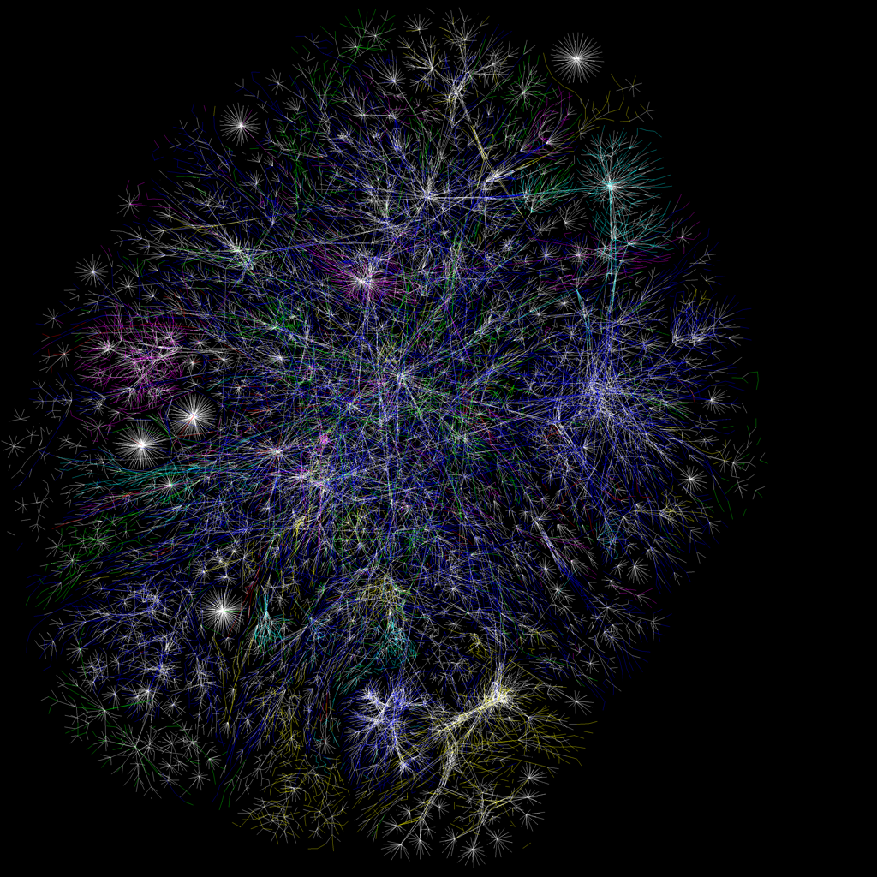
Map of Internet

Slide 51
Questions?

Slide 52
Announcement & Reminder (Sep 25)
Programming Project # 1 has also been posted on the class website:
Due Monday Oct 15 11:59pm
Hw #1: due: Friday Oct 6 11:59pm
Please start working on them, if you haven’t started yet!

Slide 53
What We Learned Last Time (Sep 21)
We have reviewed:
What is a network? What is a computer/data network? Compare w/ diff. networks (telephone, postal office, transportation networks, …)
“bolts-&-nuts” view vs. service perspective
Network is a shared resource!
ways to share (“multiplex”) resources? TDMA, FDMA, CDMA, …
Packet switching vs. circuit switching:
packets, packet switching and statistical multiplexing
For “bursty” data applications
store-&-forward
delay, losses and congestion vs. call blocking
New: four types of delays
propagation, transmission, processing & queueing delays
Architecture: layering & hourglass
different technologies, “boxes” (routers, switches), & apps
Protocols and Interfaces (API)

Slide 54
Internet Hourglass Architecture
enabling diverse applications
& new types of end devices
p2p file sharing, skype, YouTube, Netflix, Cloud Computing
bitTorrent, DHT, SIP, DASH, ….
accommodating evolving
& new technologies
network edge/end hosts
network core
WiFi, Bluetooth,
Docsis, gMPLS,
DWDM/fiber, …,
3G/4G cellular,
….

Slide 55
Layered Architecture
Layering simplifies the architecture of complex system
Layer N relies on services from layer N-1 to provide a service to layer N+1
Interfaces define the services offered
Service required from a lower layer is independent of its implementation
Layer N change doesn’t affect other layers
Information/complexity hiding
Similar to object oriented methodology
Notes:
Network software is designed using layered approach to make the complex system manageable. Layer N uses the services provided by the lower layers to offer a service to upper layers. Interfaces define the services offered by a layer.
By keeping the interface same, the implementation of a layer can be changed without affecting the rest of the system. This type of information and complexity hiding is similar to object oriented approach.

Slide 56
Protocols and Services
Protocols are used to implement services
Peering entities in layer N provide service by communicating with each other using the service provided by layer N-1
Logical vs physical communication
Notes:
Lets look at the relation between services, protocols and interfaces. The interface of a layer defines the service provided by that layer and protocols are used to implement the service according to the interface specification. The protocol is between peer entities and they communicate with each other using the service provided by the lower layer.
Here is an example of communication between peer layers. It is important to understand the difference between logical vs physical communication. For example, layer 4’s communicate with each other using a layer 4 protocol. They exchange messages as if they can talk to each other directly. But in reality, messages go thru the router. Layer 4 uses the services offered by layer 3 to send the message to layer 4 on the other side. The dotted line shows the logical communication path and the solid line, physical communication path. This approach allows design, implementation and testing of a layer software independent of other layers.

Slide 57
Protocol Packets
Protocol data units (PDUs):
packets exchanged between peer entities
Service data units (SDUs):
packets handed to a layer by an upper layer
Data at one layer is encapsulated in packet at a lower layer
Envelope within envelope: PDU = SDU + (optional) header or trailer
Notes:
Some terminology here. The packets exchanged between peer entities are called PDUs. Packets handed to a layer by an upper layer is called SDU. Data at one layer is encapsulated in a PDU packet at the next layer. This is like putting an envelope within another envelope. A protocol at a layer doesn’t interpret the data handed by the upper layer. For example, application layer data such as HTTP request message is encapsulated in TCP packet, which in turn in IP and then in Ethernet packet. Each of the layers treat the upper layer’s packet as simply payload.

Slide 58
Encapsulation
source
message
M
application
transport
network
link
physical
segment
H_{t}
M
H_{t}
datagram
H_{n}
H_{n}
H_{t}
M
frame
H_{l}
H_{n}
H_{t}
M
link
physical
switch
destination
H_{n}
H_{t}
M
network
link
physical
M
application
transport
network
link
physical
H_{l}
H_{n}
H_{t}
M
H_{n}
H_{t}
M
H_{t}
M
H_{n}
H_{t}
M
H_{l}
H_{n}
H_{t}
M
router

Slide 59
Internet Protocol Stack
application: supporting network applications
FTP, SMTP, HTTP, DASH, …
transport: process-process data transfer
TCP, UDP
network: routing of datagrams from source to destination
IP, routing protocols
link: data transfer between neighboring network elements
PPP, Ethernet
physical: bits “on the wire”
application
transport
network
link
physical
CSci4211: Introduction

Slide 60
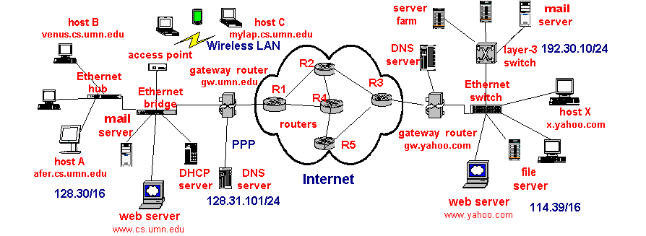
A Simplified Illustration of Internet

Slide 61
Applications and Application Layer Protocols
Basics of Building Applications: a networking perspective
application processes and inter-process communications
API: socket overview
“Addressing” processes (“whom is the other party is”)
IP addresses and port numbers
What transport services to use?
TCP and UDP
Application Structures
client-server -→ data centers, cloud services
peer-to-peer
Case studies: applications/application protocols
world wide web and HTTP: transaction-oriented app protocol
email and SMTP (& POP, IMAP): session-based app protocol
download
“wireshark”
software!

Slide 62

Client-server architecture
server:
always-on host
permanent IP address
server farms for scaling
clients:
communicate with server
may be intermittently connected
may have dynamic IP addresses
do not communicate directly with each other
client/server

Slide 63
Web and HTTP Summary
Transaction-oriented (request/reply), use TCP, port 80
Non-persistent (HTTP/1.0) vs. persistent (HTTP/1.1)
Client
Server
GET /index.html HTTP/1.0
HTTP/1.0
200 Document follows
Content-type: text/html
Content-length: 2090
-- blank line --
HTML text of the Web page

Slide 64
HTTP request message
two types of HTTP messages: request, response
HTTP request message:
ASCII (human-readable format)
carriage return character
request line
(GET, POST,
HEAD commands)
line-feed character
GET /index.html HTTP/1.1\r\n
Host: www-net.cs.umass.edu\r\n
User-Agent: Firefox/3.6.10\r\n
Accept: text/html,application/xhtml+xml\r\n
Accept-Language: en-us,en;q=0.5\r\n
Accept-Encoding: gzip,deflate\r\n
Accept-Charset: ISO-8859-1,utf-8;q=0.7\r\n
Keep-Alive: 115\r\n
Connection: keep-alive\r\n
\r\n
header
lines
carriage return,
line feed at start
of line indicates
end of header lines
* Check out the online interactive exercises for more examples: http://gaia.cs.umass.edu/kurose_ross/interactive/

Slide 65
HTTP response message
status line
(protocol
status code
status phrase)
HTTP/1.1 200 OK\r\n
Date: Sun, 26 Sep 2010 20:09:20 GMT\r\n
Server: Apache/2.0.52 (CentOS)\r\n
Last-Modified: Tue, 30 Oct 2007 17:00:02 GMT\r\n
ETag: "17dc6-a5c-bf716880"\r\n
Accept-Ranges: bytes\r\n
Content-Length: 2652\r\n
Keep-Alive: timeout=10, max=100\r\n
Connection: Keep-Alive\r\n
Content-Type: text/html; charset=ISO-8859-1\r\n
\r\n
data data data data data ...
header
lines
data, e.g.,
requested
HTML file
* Check out the online interactive exercises for more examples: http://gaia.cs.umass.edu/kurose_ross/interactive/

Slide 66
Email Summary
client
Alice
Message
transfer
agent
(MTA)
Message
user agent
(MUA)
SMTP
outgoing mail queue
SMTP
over TCP
(RFC 821)
POP3 (RFC 1225)/ IMAP (RFC 1064)
for accessing mail
server
port 25
Bob
Message
transfer
agent
(MTA)
Message
user agent
(MUA)
user mailbox

Slide 67
Sample SMTP Interaction
S: 220 hamburger.edu
C: HELO crepes.fr
S: 250 Hello crepes.fr, pleased to meet you
C: MAIL FROM: <alice@crepes.fr>
S: 250 alice@crepes.fr... Sender ok
C: RCPT TO: <bob@hamburger.edu>
S: 250 bob@hamburger.edu ... Recipient ok
C: DATA
S: 354 Enter mail, end with "." on a line by itself
C: Do you like ketchup?
C: How about pickles?
C: .
S: 250 Message accepted for delivery
C: QUIT
S: 221 hamburger.edu closing connection

Slide 68
Reminders (Oct 2)
Hw #1: due: this Friday Oct 6 11:59pm
submission online using the class Moodle site
Programming Project # 1: due Monday Oct 15 11:59pm
Week of Oct 16: Take-Home Quiz I!

Slide 69
What We Learned Last Time (Sept 25) …
Review applications/application protocols
world wide web and HTTP: transaction-oriented app protocol; non-persistent vs. persistent; maintaining “states” across request-reply transactions via cookie
email and SMTP (& POP, IMAP): session-based app protocol
Domain Name System:
Mapping domain (DNS) name to IP addresses
Briefly: Peer-to-Peer File Sharing and DHT
Network Socket Programming
BSD socket programming interfaces: TCP vs. UDP sockets
Socket programming in Python
Socket programming in Java

Slide 70
Internet Domain Names
Hierarchical: anywhere from two to possibly infinity
Examples: afer.cs.umn.edu, lupus.fokus.gmd.de
edu, de: organization type or country (a “domain”)
umn, fokus: organization administering the “sub-domain”
cs, fokus: organization administering the host
afer, lupus: host name (have IP address)
. (root)
. com
. uk
. edu
umn.edu
yahoo.com
cs.umn.edu
itlabs.umn.edu
www.yahoo.com
afer.cs.umn.edu

Slide 71
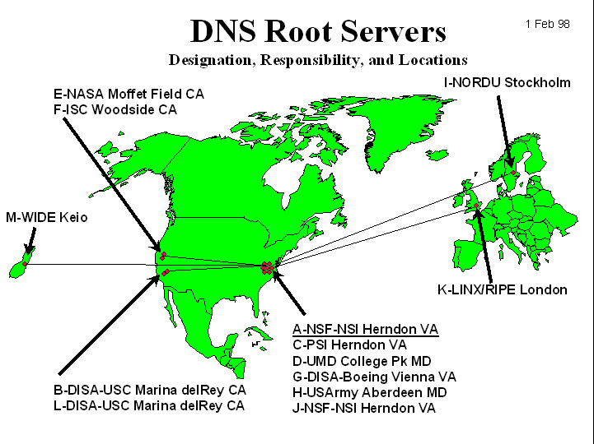
DNS: Root name servers
contacted by local name server that can not resolve name
root name server:
contacts authoritative name server if name mapping not known
gets mapping
returns mapping to local name server
~ dozen root name servers worldwide

Slide 72
DNS: iterated queries
root name server
recursive query:
puts burden of name resolution on contacted name server
heavy load?
iterated query:
contacted server replies with name of server to contact
“I don’t know this name, but ask this server”
iterated query
2
3
4
7
local name server
dns.aol.com
intermediate name server
dns.umn.edu
5
6
1
8
authoritative name server
dns.cs.umn.edu
requesting host
homeboy.aol.com
afer.cs.umass.edu

Slide 73
DNS: caching and updating records
once (any) name server learns mapping, it caches mapping
cache entries timeout (disappear) after some time
update/notify mechanisms under design by IETF
RFC 2136
http://www.ietf.org/html.charters/dnsind-charter.html

Slide 74
DNS records
DNS: distributed db storing resource records (RR)
RR format: (name, value, type,ttl)
Type=A
name is hostname
value is IP address
Type=CNAME
name is an alias name for some “canonical” (the real) name
value is canonical name
Type=NS
name is domain (e.g. foo.com)
value is IP address of authoritative name server for this domain
Type=MX
value is hostname of mailserver associated with name

Slide 75
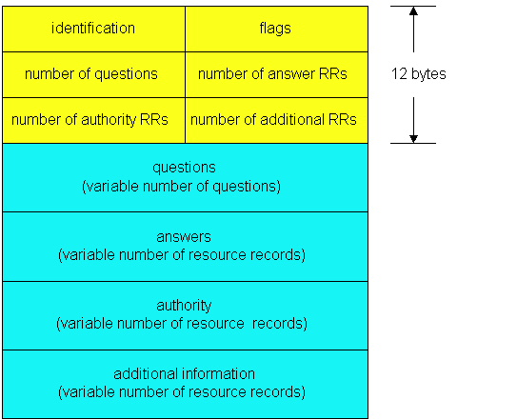
DNS protocol, messages
Name, type fields
for a query
RRs in reponse
to query
records for
authoritative servers
additional “helpful”
info that may be used

Slide 76
DNS Protocol
Query/Reply: use UDP, port 53
Transfer of DNS Records between authoritative and replicated servers: use TCP

Slide 77
Peer-to-Peer Paradigm
How do we implement peer-to-peer model?
Is email peer-to-peer or client-server application?
How do we implement peer-to-peer using
client-server model?
Difficulty in implementing “pure” peer-to-peer model?
How to locate your peer?
Centralized “directory service:” i.e., white pages
Napters
Unstructured: e.g., “broadcast” your query: namely, ask your friends/neighbors, who may in turn ask their friends/neighbors,
Freenet
Structured: Distributed hashing table (DHT)

Slide 78
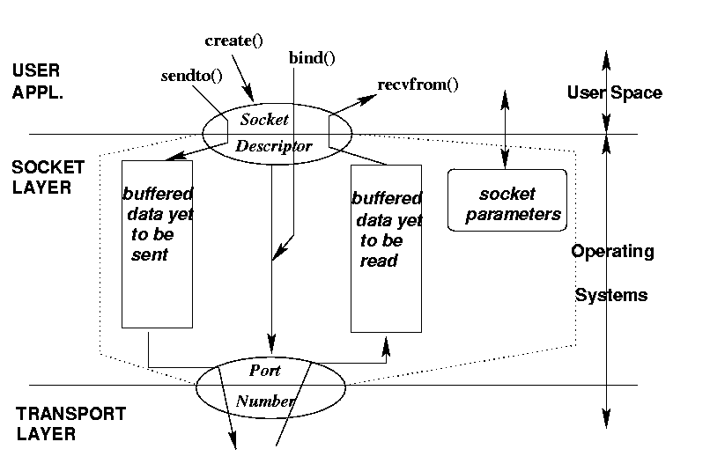
Socket: Conceptual View
socket()

Slide 79
A summary of BSD Socket
protocol
localAddr,localPort
remoteAddr, remotePort
conn-oriented server
socket()
bind()
listen(), accept()
conn-oriented client
socket()
connect()
connectionless server
socket()
bind()
recvfrom()
connectionless client
socket()
bind()
sendto()

Slide 80
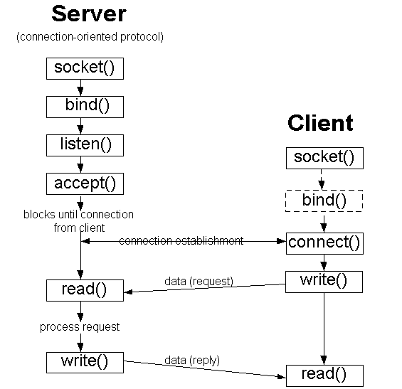
BSD Socket Programming Flows (connection-oriented)

Slide 81
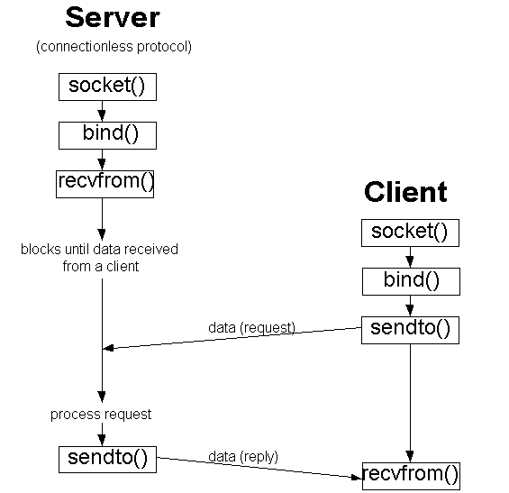
BSD Socket Programming (connectionless)

Slide 82
Reminders (Oct9)
Programming Project # 1:
due this Sunday Oct 15 11:59pm!
Next Week: Take-Home Quiz I!
Hand-out Monday Oct 16,
Due Friday Oct 20 11:59pm

Slide 83
What We Learned Last Time (Oct 2) …
Review Domain Name System (DNS)
Mapping domain (DNS) name to IP addresses
Briefly Review Peer-to-Peer File Sharing and DHT
Transport Layer: UDP vs. TCP
port numbers: multiplexing/de-multiplexing app processes
checksum
UDP: connectionless datagram service
TCP: connect-oriented, reliable, in-order byte streams (fully duplex)
Connection set-up and tear-down
Reliable data transfer (today)
flow control & control congestion (next Monday)

Slide 84
UDP: User Datagram Protocol [RFC 768]
“no frills,” “bare bones” Internet transport protocol
“best effort” service, UDP segments may be:
lost
delivered out of order to app
connectionless:
no handshaking between UDP sender, receiver
each UDP segment handled independently of others
Why is there a UDP?
no connection establishment (which can add delay)
simple: no connection state at sender, receiver
small segment header
no congestion control: UDP can blast away as fast as desired

Slide 85
UDP Datagram Format
often used for streaming multimedia apps
loss tolerant
rate sensitive
other UDP uses
DNS
SNMP
reliable transfer over UDP: add reliability at application layer
application-specific error recovery!
32 bits
Length, in
bytes of UDP
segment,
including
header
source port #
dest port #
length
checksum
Application
data
(message)
UDP segment format

Slide 86
TCP: Overview
point-to-point:
one sender, one receiver
reliable, in-order byte steam:
no “message boundaries”
pipelined:
TCP congestion and flow control set window size
send & receive buffers
full duplex data:
bi-directional data flow in same connection
MSS: maximum segment size
connection-oriented:
handshaking (exchange of control msgs) init’s sender, receiver state before data exchange
flow controlled:
sender will not overwhelm receiver
CSci4211: Weekly Summary

Slide 87
TCP Segment Structure
32 bits
source port #
dest port #
counting
by bytes
of data
(not segments!)
URG: urgent data
(generally not used)
sequence number
ACK: ACK #
valid
acknowledgement number
head
len
not
used
U
rcvr window size
A
P
R
S
F
PSH: push data now
(generally not used)
checksum
ptr urgent data
# bytes
rcvr willing
to accept
Options (variable length)
RST, SYN, FIN:
connection estab
(setup, teardown
commands)
application
data
(variable length)
Internet
checksum
(as in UDP)
CSci4211: Weekly Summary

Slide 88
TCP Seq. # & Ack.#
Host A
Host B
Seq. #’s:
byte stream “number”of first byte in segment’s data
ACKs:
seq # of next byte expected from other side
User
types
‘C’
Seq=42, ACK=79, data = ‘C’
host ACKs
receipt of
‘C’, echoes
back ‘C’
Seq=79, ACK=43, data = ‘C’
host ACKs
receipt
of echoed
‘C’
Seq=43, ACK=80
time
red: A-to-B green: B-to-A
simple telnet scenario
CSci4211: Weekly Summary

Slide 89
TCP: Some Key Issues
How to design a simple “reliable” transfer protocol?
stop-&-wait protocol (or alternative bit protocol)
How to deal with “lost” packets?
how to detect a packet is “lost”?
need to set a timer (“retransmission timer”)
what value shall we choose to set the timer?
what to do with “lost” packets?
retransmit the “lost” packet when timer goes off
What problem packet retransmission create?
(potential) duplicate packets!
e.g., when a “lost” packet is not actually lost, but takes longer to get delivered, after timer times out
how to recognize duplicate packets?
sequence # : but why do we need sequence #? how many bits shall we use?

Slide 90


Simple Reliable Data Transfer Protocol
Host A
Host B
Error Scenarios:
data pkt lost
send data pkt
data = ‘C’
& set retrans.
timer
X
data pkt lost
timer
goes off!
resend data pkt
data = ‘C’
ACK
time
CSci4211: Weekly Summary

Slide 91
Simple Reliable Data Transfer Protocol
Host A
Host B
Error Scenarios:
data pkt lost
ack pkt lost
send data pkt
data = ‘C’
& set retrans.
timer
ACK
X
ACK pkt lost
timer
goes off!
resend data pkt
data = ‘C’
time
Note: Host A can’t tell whether the two error scenarios apart: whether data packet or ACK packet is lost
CSci4211: Weekly Summary

Slide 92
Simple Reliable Data Transfer Protocol
Host A
Host B
Error Scenarios:
data pkt lost
ack pkt lost
retrans. timer goes off (but none is lost!) ➔ duplicate packets
send data pkt
data = ‘C’
& set retrans.
timer
ACK
data = ‘C’
timer goes off!
resend data pkt
Host B: did host A send
“C” or “CC” ?
time
Note: Host B has no idea that
retrans. timer at Host A went off!
CSci4211: Weekly Summary

Slide 93
Simple Reliable Data Transfer Protocol
Host A
Host B
send data pkt
data = ‘C’
Why Do We Need Seq # ?
& set retrans.
timer
ACK
data = ‘C’
Host B: Did host A send
“C” or “CC” ?
Error Scenario (retrans. timer goes off) vs. Normal Scenario (host A sends another data pkt (with char “C”) look exactly the same from Host B’s perspective!
time
CSci4211: Weekly Summary

Slide 94
Simple Reliable Data Transfer Protocol
Host A
Host B
send data pkt
expecting data pkt
w/ seq. 42;
Seq=42, data = ‘C’
& set retrans.
timer
received pkt. w/seq=42
send ACK w/ ack=43;
expecting data pkt w/ seq=43
ACK ack=43
Seq=42, data = ‘C’
timer
goes off!
ACK ack=43
Duplicate data pkt,
resend ACK w/ ack=43!
time
CSci4211: Weekly Summary

Slide 95
Simple Reliable Data Transfer Protocol
Host A
Host B
send data pkt
expecting data pkt
w/ seq. 42;
Seq=42, data = ‘C’
& set retrans.
timer
received pkt. w/seq=42
send ACK w/ ack=43;
expecting data pkt w/ seq=43
ACK ack=43
Seq=42, data = ‘C’
timer
goes off!
ACK ack=43
Duplicate data pkt,
resend ACK w/ ack=43!
time
CSci4211: Weekly Summary

Slide 96
Simple Reliable Data Transfer Protocol
Host A
Host B
send data pkt
expecting data pkt
w/ seq. 42;
Seq=42, data = ‘C’
& set retrans.
timer
received pkt. w/seq=42
send ACK w/ ack=43;
expecting data pkt w/ seq=43
ACK ack=43
Seq=43, data = ‘C’
received new data pkt
as expected!
send ACK w/ ack=44;
expecting data pkt w/ seq=43
ACK ack=44
time
With seq. included in the data packet, error Scenario (retrans. timer goes off) vs. Normal Scenario (host A sends another data pkt (with char “C”) can now be distinguished by host B!
CSci4211: Weekly Summary

Slide 97
A Simple Reliable Data Transfer Protocol
“Stop & Wait” Protocol (aka “Alternate Bit” Protocol)
Sender algorithm:
Send Phase: send data segment (n bytes) w/ seq=x, buffer data segment, set timer
Wait Phase: wait for ack from receiver w/ ack= x+n
if received ack w/ ack=x+n,
set x:=x+n, and go to sending phase with next data segment
if time out, resend data segment w/ seq=x.
if received ack w/ ack != x+n, ignore (or resend data segment w/ seq=x)
Receiver algorithm:
Wait-for-Data:
wait for data packet with the (expected) next-seq = x
if received Data packet w/ seq. =x and of size n bytes: send ACK pkt w/ ack = x+n; set next-seq:= x+n; go back to “Wait-for-Data”;
If received Data packet w/ seq != x, (re-)send ACK pkt w/ ack= next-seq; go back to “Wait-for-Data”;
Q: what is the “state” information maintained at the sender & receiver, resp.?
CSci4211: Weekly Summary

Slide 98
SRDTP: Finite State Machine
event
: state
action
: transition
Receiver FSM?
Sender FSM
Upper layer:
send data (n bytes)
make data sgt, seq = x, set timer
pass data sgt to lower layer
?
receive Ack w/ ack != x+n
?
Send
phase
Wait
phase
no op, or resend data sgt
time out
resend data sgt
receive Ack w/ ack = x+n
x: = x+n, stop timer
info (“state”) maintained at sender:
phase it is in (send, or wait), ack expected, data sgt sent (seq #), timer
CSci4211: Weekly Summary

Slide 99
TCP Connection Set Up
Three way handshake:
Step 1: client sends TCP SYN control segment to server
specifies initial seq #
Step 2: server receives SYN, replies with SYN+ACK control segment
ACKs received SYN
specifies server → receiver initial seq. #
Step 3:client receives SYN+ACK,
replies with ACK segment (which may contain 1st data segment)
TCP sender, receiver establish “connection” before exchanging data segments
initialize TCP variables:
seq. #s
buffers, flow control info
client: end host that initiates connection
server: end host contacted by client
CSci4211: Weekly Summary

Slide 100
TCP 3-Way Hand-Shake
client
server
Question:
a. What kind of “state” client and server need to maintain?
b. What initial sequence # should client (and server) use?
initiate
connection
SYN, seq=x
SYN
received
SYN+ACK, seq=y, ack=x
connection
established
ACK, seq=x, ack=y
connection
established
(1st data segment)
CSci4211: Weekly Summary

Slide 101
TCP: Some Key Issues
TCP Connection Set-up Design Questions
Why Three-Way, not, say Two-Way, Handshake?
e.g., client: SYN (x); server: SYNACK(y,x)
Why Do Both Client and Server Need to Choose a Unique Seq. # to number its byte stream?
Unique → each connection between the same source and destination host pair (and port number pair) must have a different sequence number
Recall: each TCP connection is identified by a 5-tuple <src IP, dst IP, src port, dst port, TCP>
Problems: “old” duplicate packets (“ghost” packets) from previous (instantiation of the “same”) connection
➔ can create “half-open” connection (that we want to avoid!)

Slide 102
Connection Setup Error Scenarios
Lost (control) packets
What happen if SYN lost? client vs. server actions
What happen if SYN+ACK lost? client vs. server actions
What happen if ACK lost? client vs. server actions
Duplicate (control) packets
What does server do if duplicate SYN received?
What does client do if duplicate SYN+ACK received?
What does server do if duplicate ACK received?
CSci4211: Weekly Summary

Slide 103
Connection Setup Error Scenarios (cont’d)
Importance of (unique) initial seq. no.?
When receiving SYN, how does server know it’s a new connection request?
When receiving SYN+ACK, how does client know it’s a legitimate response, i.e., a response to its SYN request?
Dealing with old duplicate (aka “ghost”) packets from old connections (or from malicious users)
If not careful: “TCP Hijacking” [i.e., Mitnick attack]
How to choose unique initial seq. no.?
In practice: randomly choose a number (out of 2³² possible #’s) and add to last syn# used
Other security concern:
“SYN Flood” -- denial-of-service attack
CSci4211: Weekly Summary

Slide 104
Announcement & Reminder (Oct 16)
Take-home quiz I: due Friday Oct 20 11:59pm
Has been posted to the class mailing list earlier
Please submit via Moodle class website
Programming Project # 2 Due Sunday Oct 29 11:55pm
TA Anas will provide a short overview in today’s class.
Hw #1 sample solutions (will be posted/shared with you)

Slide 105
What We Learned Last Time (Oct 9)
Reviewed: transport layer (UDP & TCP)
multiplexing/de-multiplexing: src & dst port no.’s
UDP: connectionless transport service – checksum, length
TCP: connection-oriented, reliable service
seq #, ack #, special “flags” (SYN, ACK, FIN, RST)
connection management:
3-way handshake set-up & timed wait shut-down
Key challenges: old, duplicate messages!
New material: reliable data transfer protocols
A simply reliable data transfer protocol : stop & wait
Efficiency of Protocol Design: stop-&-wait
Pipelining Protocols: Go-Back-N and Selective Repeat

Slide 106
Reliable Data Transfer Protocols
Reliable Data Transfer Protocols
basic mechanisms: seq. no, ACK, timer, retransmission
Simplest protocol: Stop-&-Wait
To ensure correct operations of the protocol:
at least 1-bit (0 or 1) needed for seq. no. (why?)
More efficient reliable data transfer protocols
What’s the problem with Stop & Wait protocol?
Sliding window protocols: Go-Back-N and Selective Repeat
concept of ”sliding window”
sender algorithm:
when to retransmit, when to send new packets? when to move window forward?
receiver algorithm:
when/what to acknowledge? when to move window forward? when to buffer packets, and when to pass to upper layer?
relationship between window size & seq. no. space

Slide 107
Simple Reliable Data Transfer Protocol
“Stop-and-Wait” Protocol (rdt3.0 in the textbook)
also called Alternating Bit Protocol
Sender:
i) send data segment (n bytes) w/ seq =x
buffer data segment, set timer, retransmit if time out
ii) wait for ACK w/ack = x+n; if received, set x:=x+n, go to i)
retransmit if ACK w/ “incorrect” ack no. received
Receiver:
i) expect data segment w/ seq =x; if received, send ACK w/ ack=x+n, set x:=x+n, go to i)
if data segment w/ “incorrect” seq no received, discard data segment, and retransmit ACK.
CSci4211: Weekly Summary

Slide 108
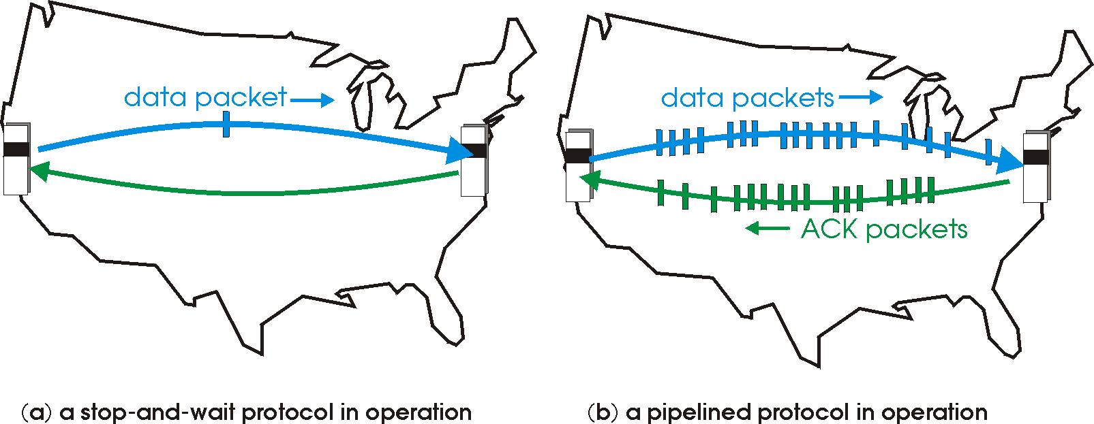
Problem with Stop-and-Wait
Problem with Stop & Wait Protocol
Sender
Receiver
first packet bit transmitted, t = 0
data (L bytes)
first packet bit arrives
RTT
ACK
ACK arrives, send next packet, t = RTT + L / R
Can’t keep the pipe full
Utilization is low
when bandwidth-delay product (R x RTT)is large!
CSci4211: Weekly Summary

Slide 109
Stop & Wait: Performance Analysis
Example:
1 Gbps connection, 15 ms end-end prop. delay,
data segment size: 1 KB = 8Kb; ack segment size: assume negligible
U _{sender}: utilization, i.e., fraction of time sender busy sending
1KB data segment every 30 msec (round trip time)
--> 0.027% x 1 Gbps = 33kB/sec throughput over 1 Gbps link
Moral of story:
network protocol limits use of physical resources!
CSci4211: Weekly Summary

Slide 110
Pipelined Protocols
Pipelining: sender allows multiple, “in-flight”, yet-to-be-acknowledged data segments
range of sequence numbers must be increased
buffering at sender and/or receiver
Two generic forms of pipelined protocols:
Go-Back-N and Selective Repeat
CSci4211: Weekly Summary

Slide 111
Pipelining: Increased Utilization
sender
receiver
first packet bit transmitted, t = 0
last bit transmitted, t = L / R
first packet bit arrives
RTT
last packet bit arrives, send ACK
last bit of 2nd packet arrives, send ACK
last bit of 3rd packet arrives, send ACK
ACK arrives, send next
packet, t = RTT + L / R
Increase utilization
by a factor of 3!
CSci4211: Weekly Summary

Slide 112
Go-Back-N: Basic Ideas
Sender:
Packets transmitted continually (when available) without waiting for ACK, up to N outstanding, unACK’ed packets
A logically different timer associated with each “in-flight” (i.e., unACK’ed) packet
timeout(n): retransmit pkt n and all higher seq # pkts in window
Receiver:
ACK packet if corrected received and in-order, pass to higher layer, NACK or ignore corrupted or out-of-order packets
“cumulative” ACK: if multiple packets received corrected and in-order, send only one ACK with ack= next expected seq no.

Slide 113
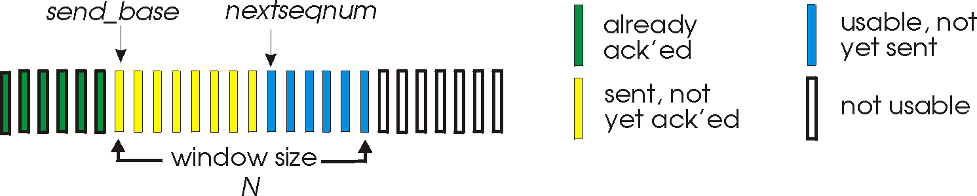
Go-Back-N: Sliding Windows
Sender:
“window” of up to N, consecutive unack’ed pkts allowed
send_base: first sent but unACKed pkt, move forward when ACK’ed
expected, not received yet
may be received
(and can be buffered,
but not ACK’ed)
rcv_base
Receiver:
rcv_base: keep track of next expected seq no, move forward when next in-order (i.e., w/ expected seq no) pkt received

Slide 114
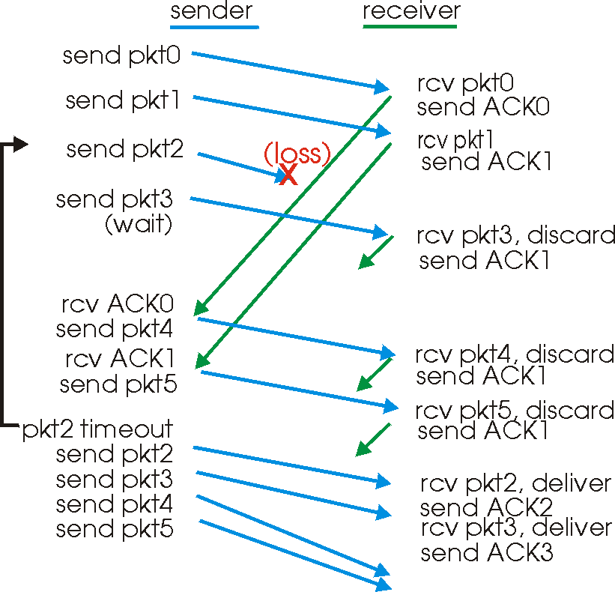
GBN in Action

Slide 115
Selective Repeat
As in Go-Back-N
Packet sent when available up to window limit
Unlike Go-Back-N
Out-of-order (but otherwise correct) is ACKed
Receiver: buffer out-of-order pkts, no “cumulative” ACKs
Sender: on timeout of packet k, retransmit just pkt k
Comments
Can require more receiver buffering than Go-Back-N
More complicated buffer management by both sides
Save bandwidth
no need to retransmit correctly received packets

Slide 116
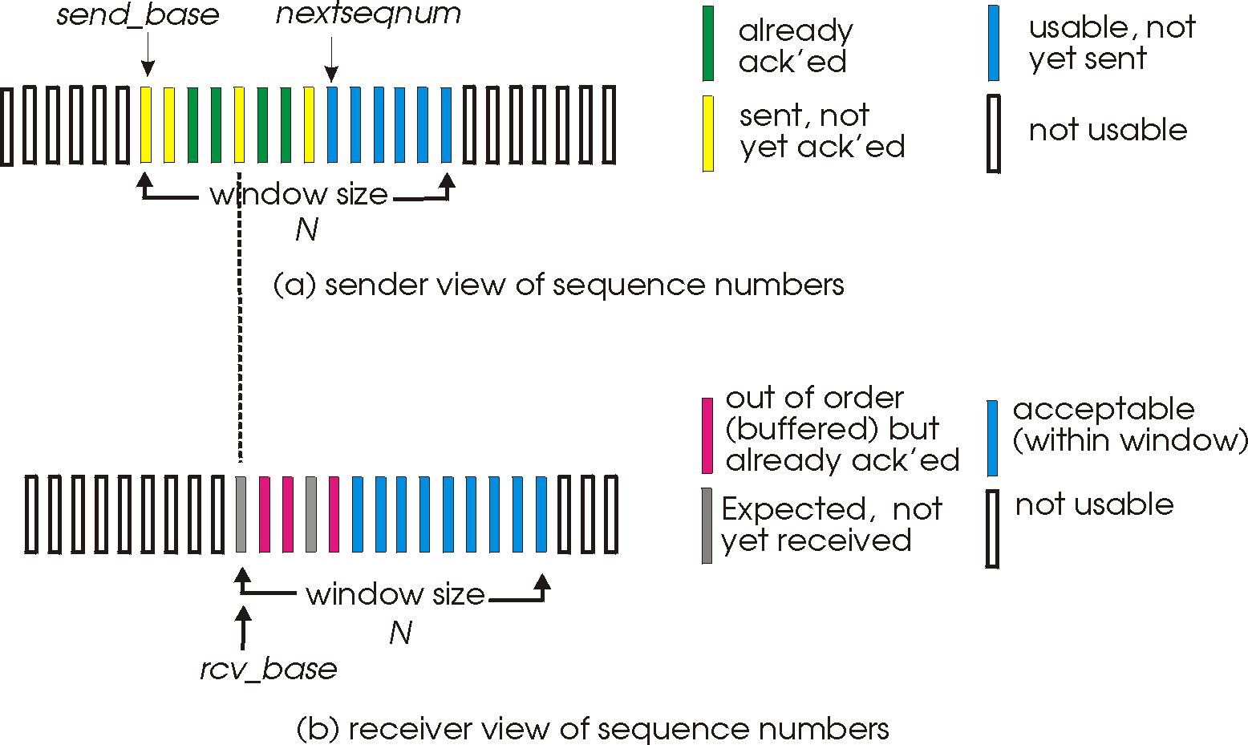
Selective Repeat: Sliding Windows

Slide 117
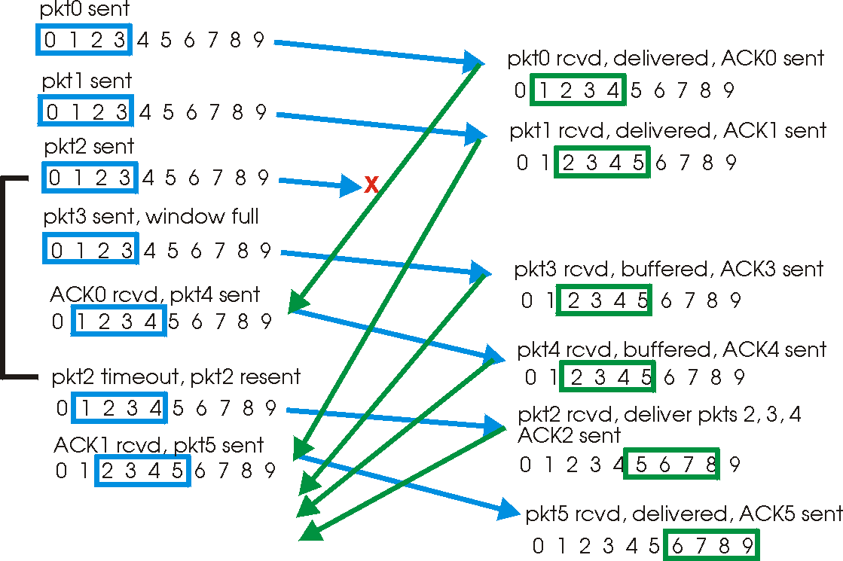
Selective Repeat in Action

Slide 118
Seqno Space and Window Size
Check out the companion website (for the 6th edition) for GBN and SR Applets:
GBN: http://media.pearsoncmg.com/aw/ecs_kurose_compnetwork_6/video_applets/GBNindex.html
SR: http://media.pearsoncmg.com/aw/ecs_kurose_compnetwork_6/video_applets/SRindex.html
OR check out the interactive Animation
on the 7th edition website
https://media.pearsoncmg.com/aw/ecs_kurose_compnetwork_7/cw/interactive-animations-cw.php

Slide 119
Seqno Space and Window Size
How big the sliding window (W) can be?
MAXSEQNO S: number of available sequence #’s
S = 2^{s} if s bits are used to present the sequence #’s
Go-Back-N: W=S won’t work!
What about Selective Repeat?
Assumptions about the underlying network are important!
If two machines are directly connected via a physical link, the network may corrupt or lose packets, but cannot deliver two packets successfully but out-of-order
GBN:
SR:

Slide 120
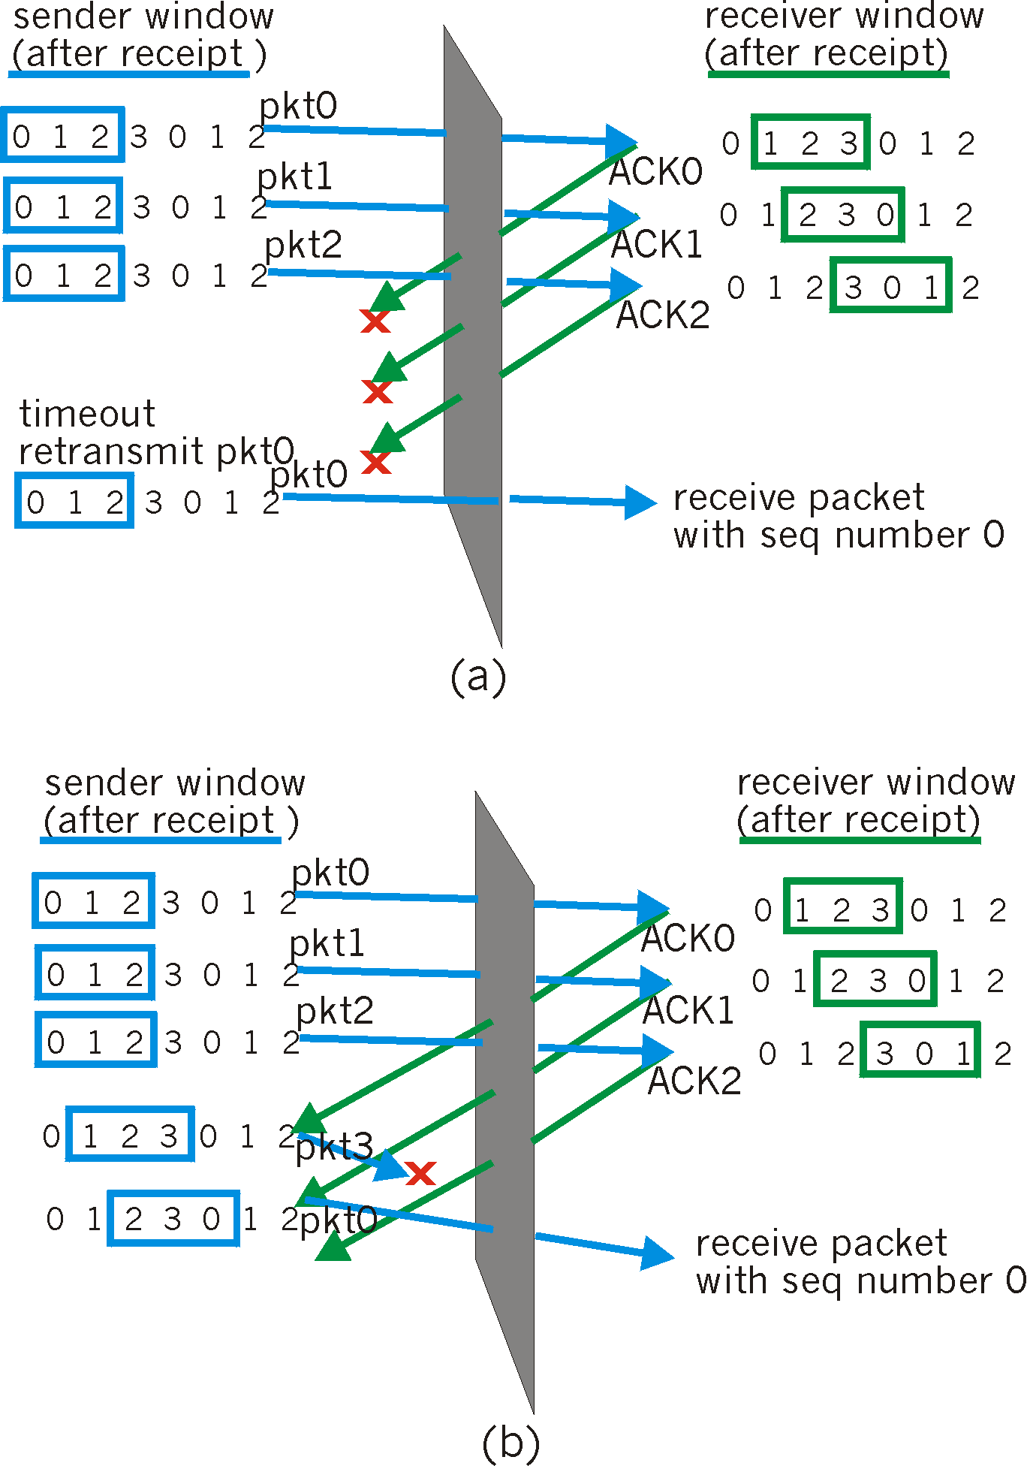
Selective Repeat: Dilemma
Example:
seq #’s: 0, 1, 2, 3
window size=3
receiver sees no difference in two scenarios!
incorrectly passes duplicate data as new in (a)
Q: what relationship between seq # size and window size?

Slide 121
Seqno Space and Window Size
How big the sliding window (W) can be?
Assumptions about the underlying network are important!
If two machines are directly connected via a physical link, the network may corrupt or lose packets, but cannot deliver two packets successfully but out-of-order
GBN: W=S-1; SR: W= S/2
If two machines are connected via a general network (more than one link), the underlying network may not only corrupt or lose packets, but also deliver two packets successfully but out-of-order, what should W be?
Key Principle: W must be (small enough relative to S) such that there can’t an old packet and a new packet sent by the sender carrying the same sequence # inside the network or at the receiver ! ➔ otherwise, the receiver will be confused!

